Slide 1
Digital Image Processing
GSP 216

Slide 2
Digital Image Processing
Pre-Processing – Correcting for radiometric and geometric errors in data
Image Rectification and Restoration
Radiometric corrections
Image Enhancements – Enhancing images so they are better suited for visual interpretation
Radiometric Enhancements
Spatial Enhancements
Spectral Enhancements

Slide 3
Pre-Processing
Pre-processing includes the initial processing of raw image data to correct for distortions/errors or to eliminate noise present in the data.
Geometric Correction
Radiometric Correction & Calibration
Noise Removal

Slide 4
Pre-Processing
Geometric Correction
Systematic Distortions occur due to the effects of the Earth’s rotation and camera angles etc. These can be easily corrected as they are predictable
Random Distortions occur due to changing terrain (relief displacement) and variations including sensor altitude
DEMs and Ground control points (GCPs) used to correct for random distortion

Slide 5
Pre-Processing
Radiometric Correction
Radiometric correction is done to reduce or correct errors in the digital numbers of images.
Done to improve interpretability and analysis of images and to standardize images.
Particularly useful when comparing scenes over a period of time

Slide 6
Pre-Processing
Radiometric Correction
Radiance measured by a sensor can vary depending the distance between the Earth and the sun and the altitude of the sun above the horizon at a given location, time of day, and time of year.
Atmospheric Correction to compensate for atmospheric scattering in the image. Improves image contrast

Slide 7
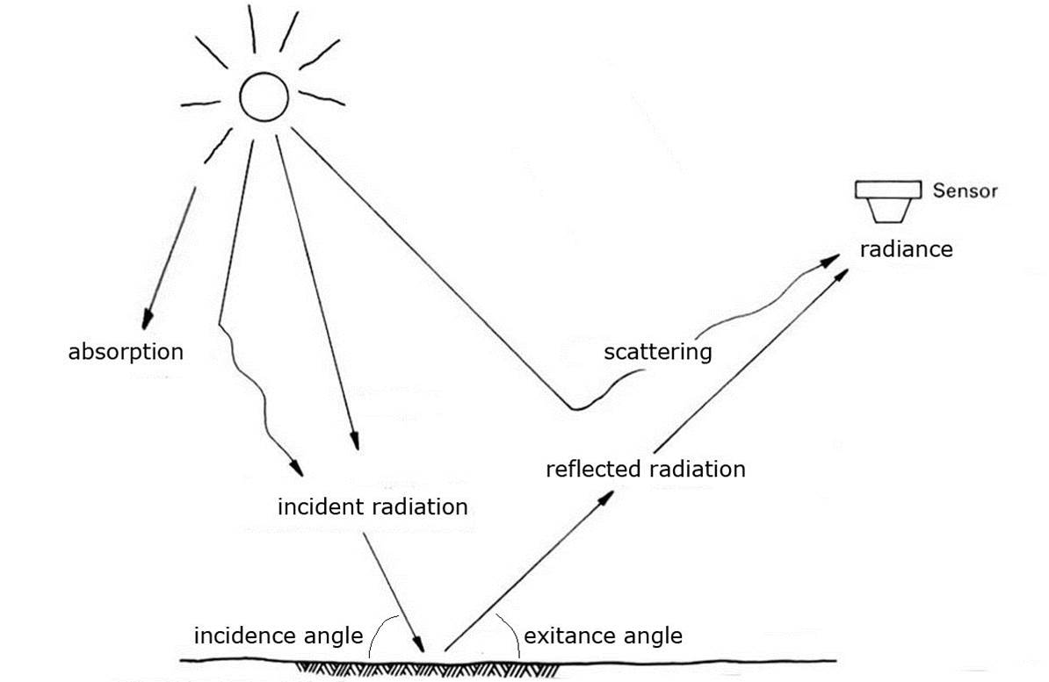
Pre-Processing
The value recorded at a given pixel includes not only the reflected radiation from the surface, but the radiation scattered and emitted by the atmosphere as well

Slide 8
Radiometric Correction Process
DN (raw value from the sensor)
Convert DNs to radiance based on the rescaling factors provided in the metadata file
At-sensor radiance
Requires additional information:
Earth-sun distance, Solar zenith angle, exoatmospheric irradiance. Often found in metadata.
Top of the Atmosphere (TOA) Reflectance
Requires knowledge of atmospheric conditions and aerosol properties at the time the image was acquired
Surface Reflectance

Slide 9
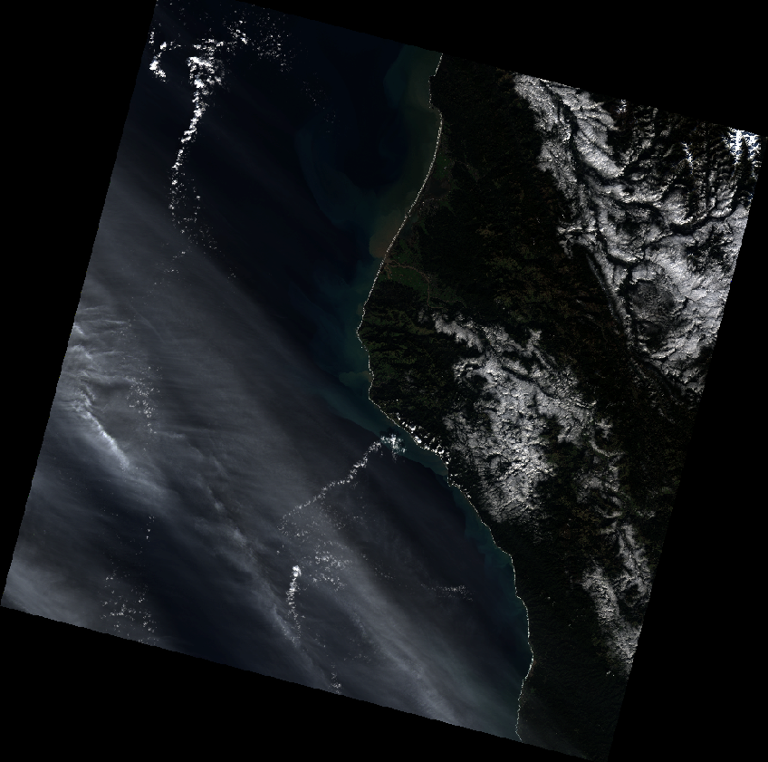
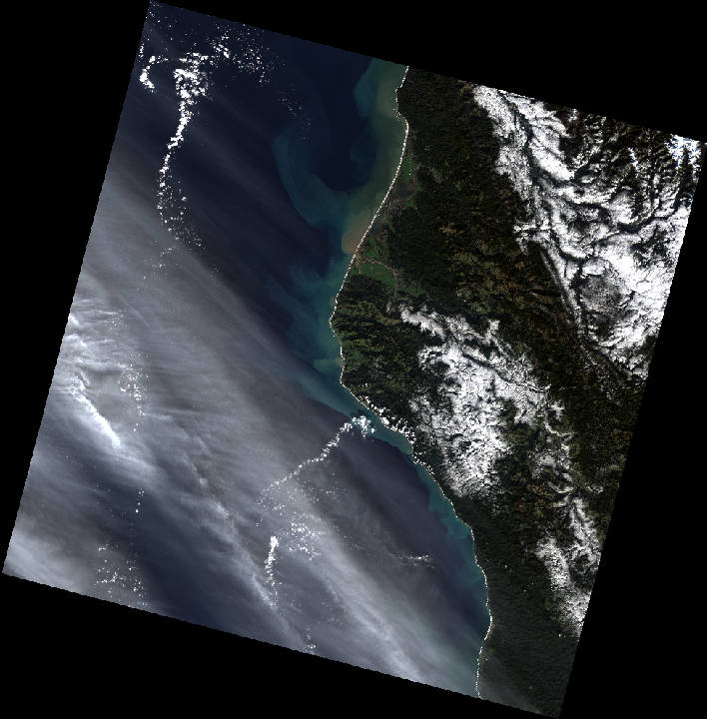
Radiometric Correction Process
DN (raw value from the sensor)
Most image processing software packages have radiometric and atmospheric correction tools
Landsat 8 Image Before (left) and After Correction (right)

Slide 10
Pre-Processing
Pre-Processed Landsat Data Products
Land Surface Reflectance Products
Available through EarthExplorer for most Landsat 4-8 scenes
Radiometric and atmospheric correction have already been applied
Additional products available through the Earth Resources Observation and Science (EROS)
Top-of-Atmosphere (TOA) radiance
Top-of-Atmosphere (TOA) reflectance

Slide 11
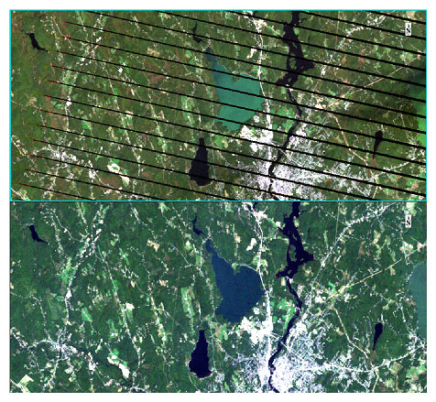
Pre-Processing
Noise Removal
Remove unwanted noise from images
Destriping
Random Noise

Slide 12
Contrast Stretching
Computer monitors have a range of brightness that they use to display images (0 to 255)
Unprocessed images often don’t use the full range
Contrast stretching improves the contrast of the image by “stretching” the Pixel Values (DNs) to take advantage of the full range

Slide 13
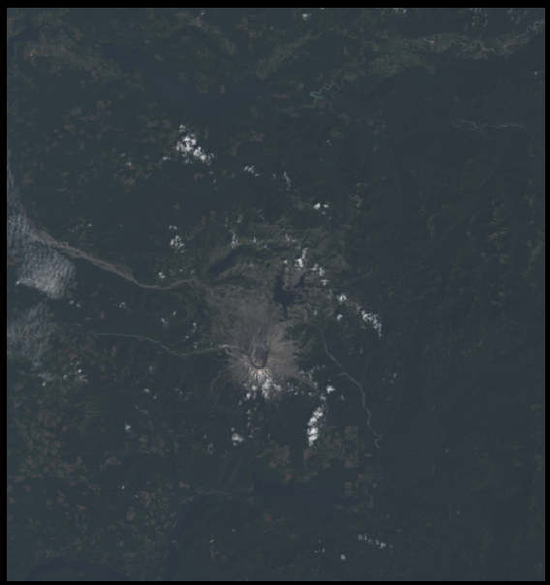
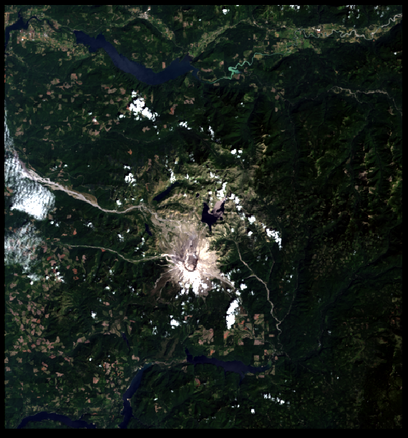
Contrast Stretching
Low Contrast Better Contrast
“No Stretch” “Stretched”

Slide 14
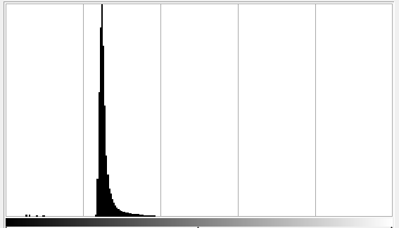
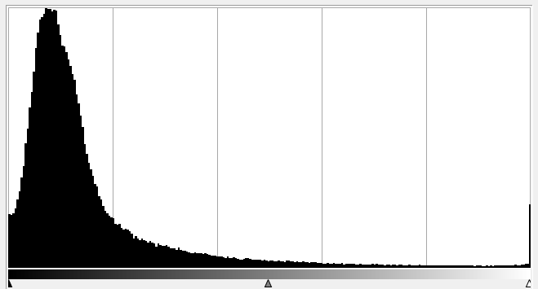
Contrast Stretching
Low Contrast Better Contrast
“No Stretch” “Stretched”

Slide 15
Spatial Filtering
Spatial Filtering is done to emphasize or deemphasize certain features depending on the spatial frequency
Spatial frequency refers to the “roughness” of the tonal variation in the image
Filters can be used to sharpen or emphasize the edges in an image or to smooth an image

Slide 16
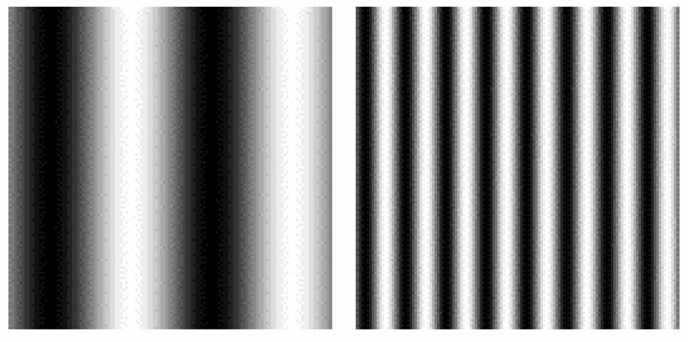
Spatial Frequency
Low High

Slide 17
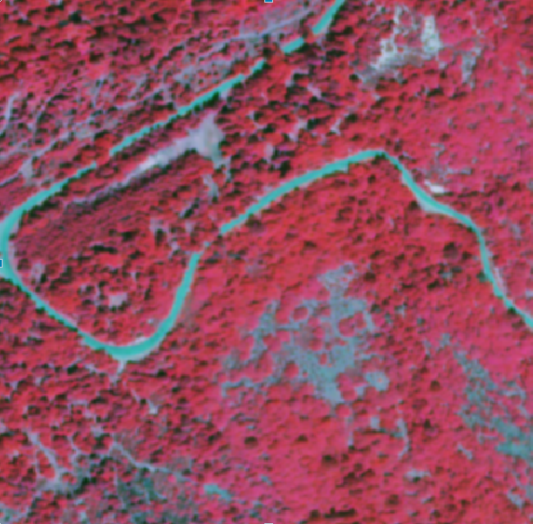
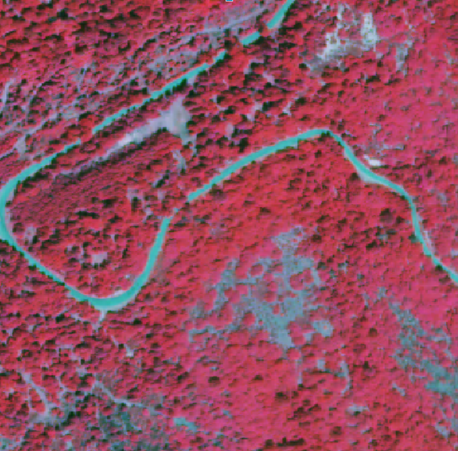
Low Pass Filters
Original Image
Low Pass Filter

Slide 18
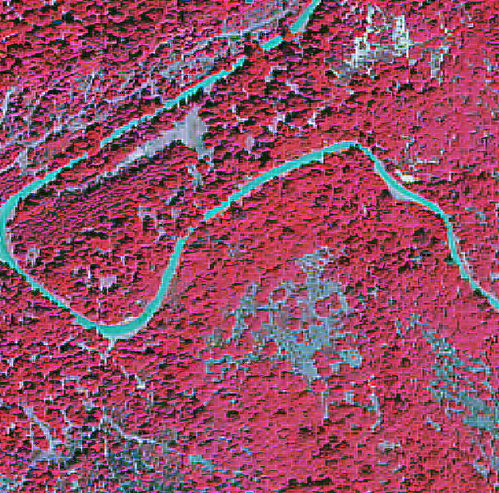
High Pass Filter
Original Image
High Pass Filter

Slide 19
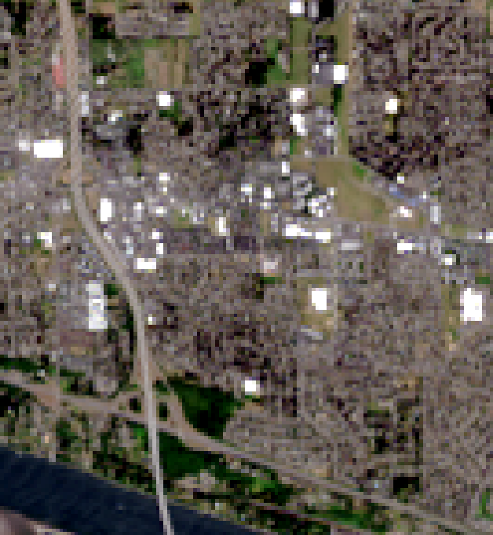
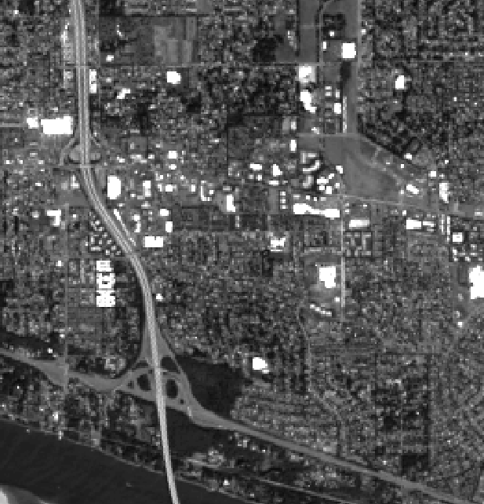
Pan Sharpening

